Slide 1
Mitochondrial genes

Slide 2
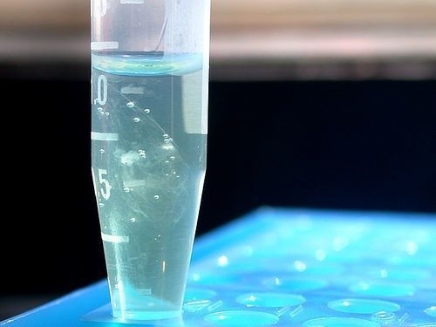
Review: Mitochondrial lab
DNA Extraction from buccal cheek cells

Slide 3
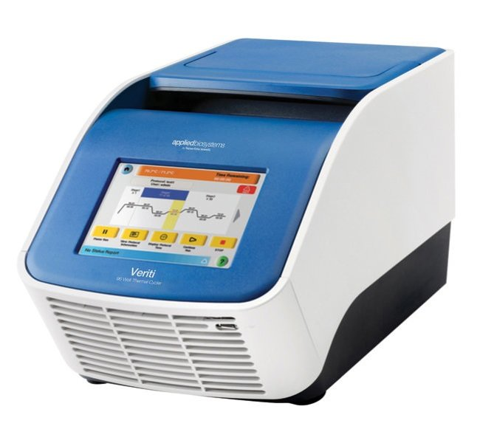
Review: Mitochondrial lab
DNA Amplification by PCR

Slide 4
Review: Mitochondrial lab
Electrophoresis

Slide 5
Ladder 1 2 3 4 Ladder
Ladder 5 6 7 8 Ladder

Slide 6
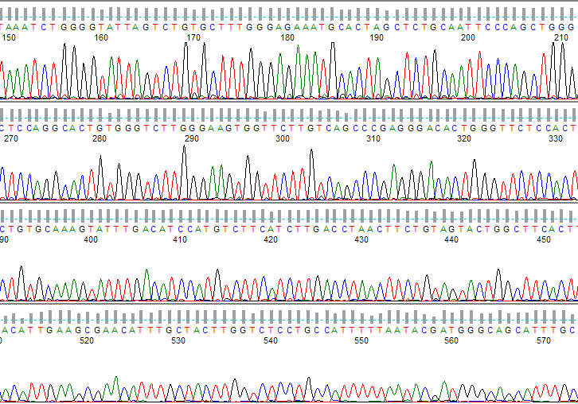
Review: Mitochondrial lab
DNA Sequencing

Slide 7
What is a gene?

Slide 8
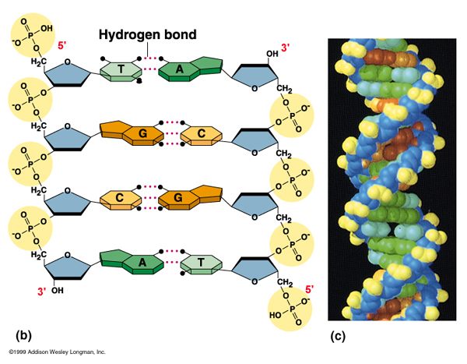
What is a gene

Slide 9

What is a word?

Slide 10
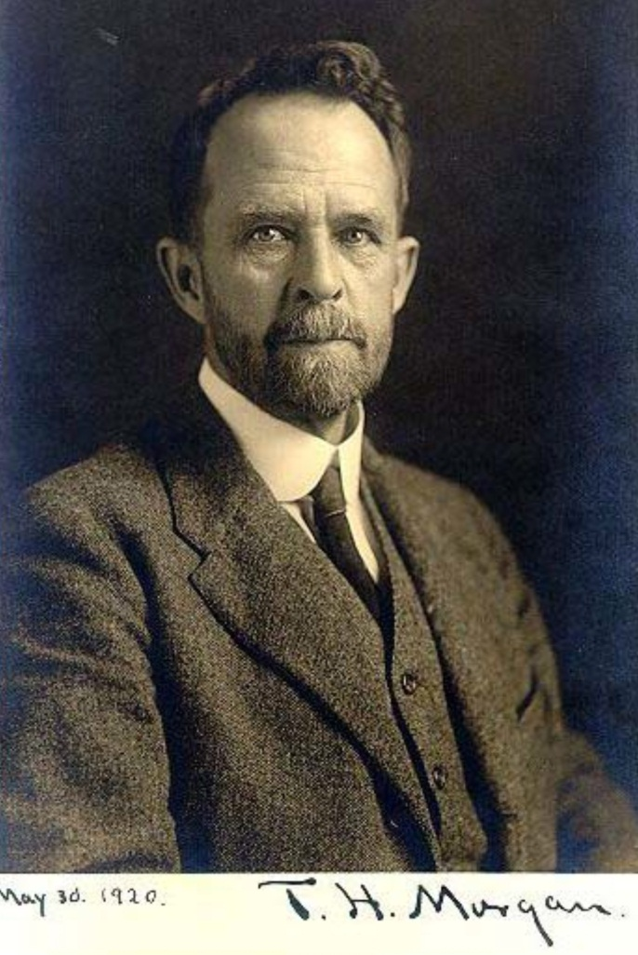

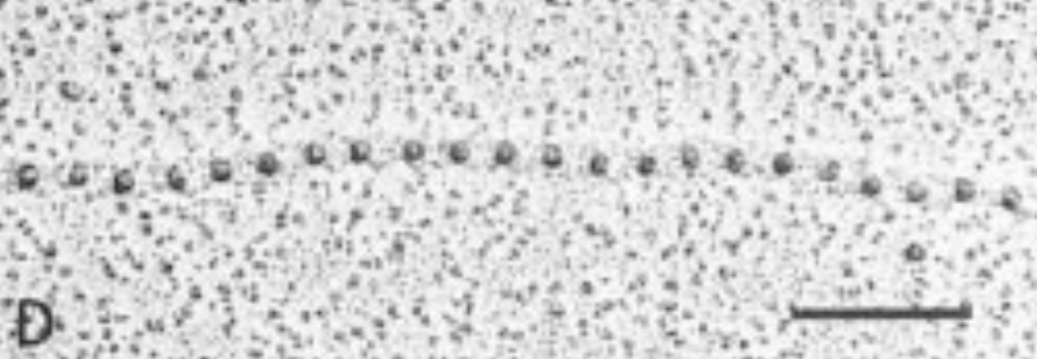
What is a gene?

Slide 11
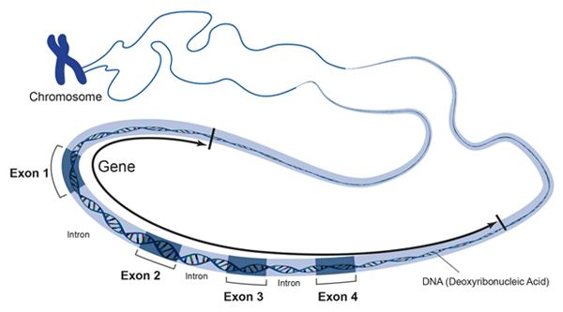
What is a gene?

Slide 12
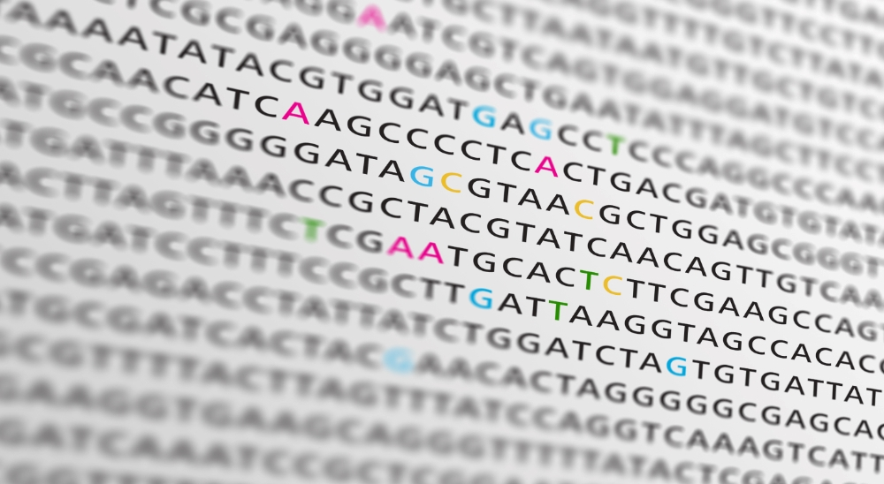
What is a gene?

Slide 13
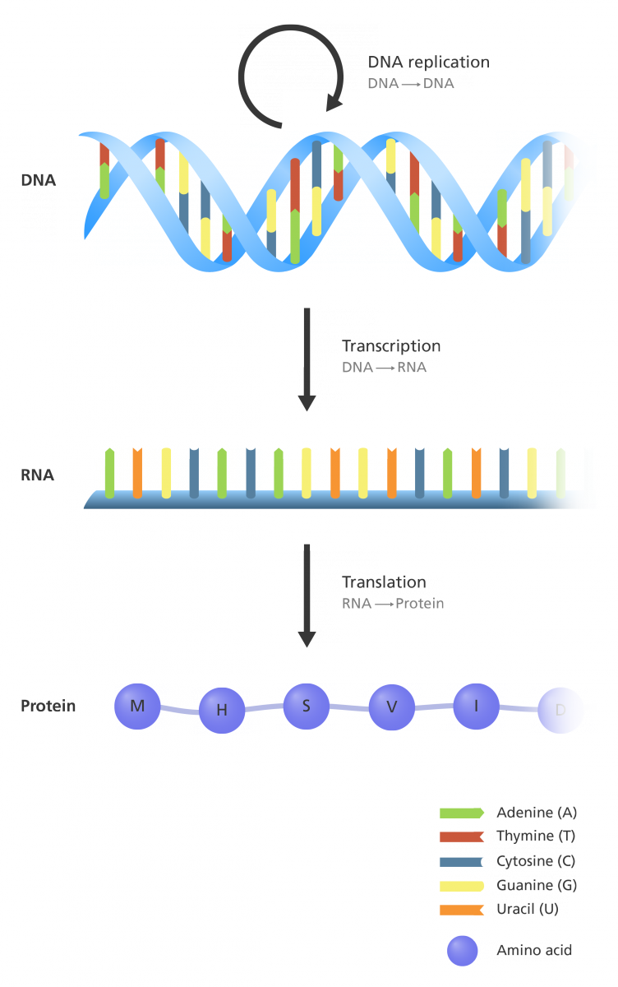
Genes contain useful information

Slide 14

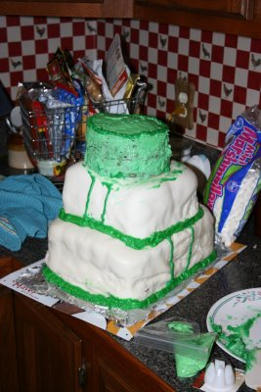
Genes contain useful information

Slide 15
One way to find information is to make comparisons

Slide 16
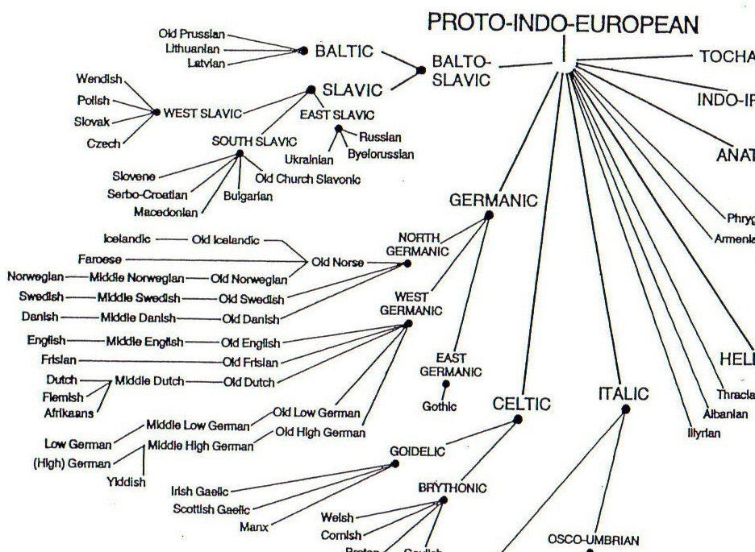
Words can be conserved
English | Dutch | German | Danish | Norwegian | Swedish | Icelandic
book (n) | boek | buch | bog | bok | bok | bók
come (v) | komen | kommen | komme | komme | komma | koma
drink (v) | drinken | trinken | drikke | drikke | dricka | drekka

Slide 17
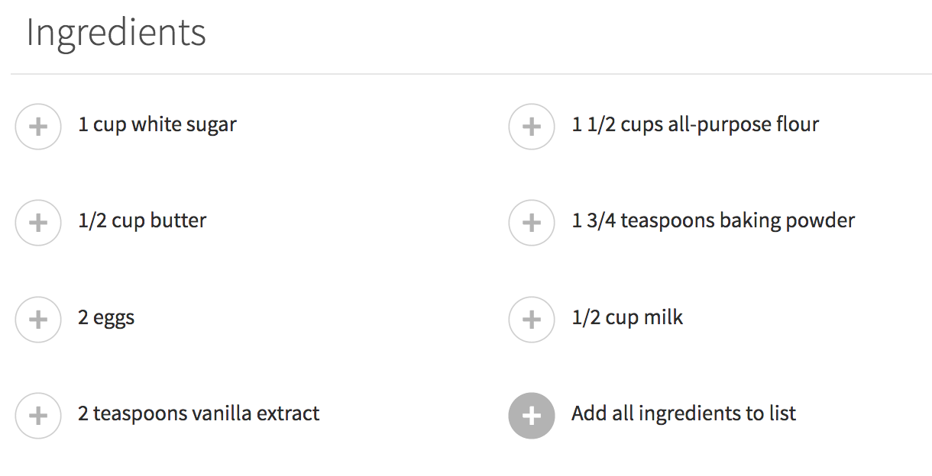

What can you change?

Slide 18
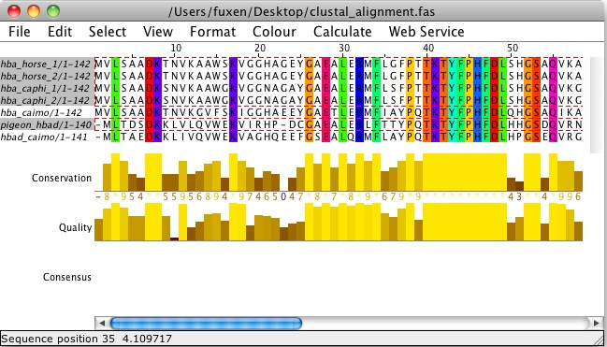
Genes can be conserved

Slide 19
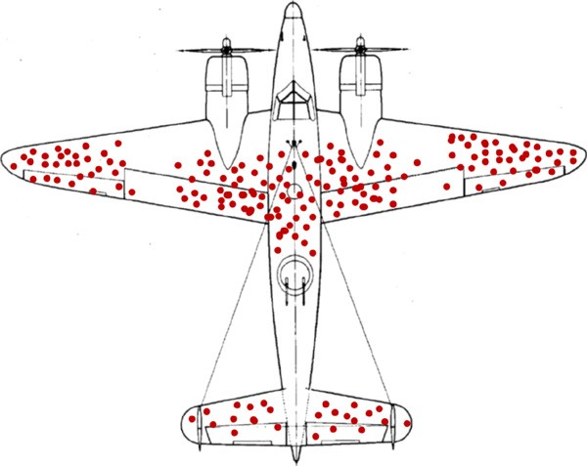
Genes with essential functions are heavily conserved
Survivorship bias

Slide 20
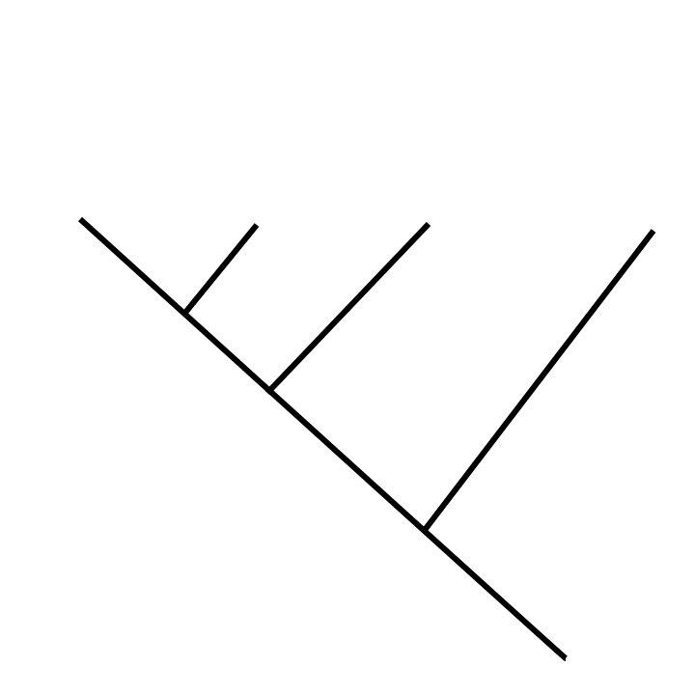
We can categorize these changes (mutations)
Transitions
Purines(A/G) mutated to Purines
Or
Pyrimidines (C/T) mutated to Pyrimidines
Transversions
Purines (A/G) to Pyrimidines (C/G) or vice versa
Indels
Gain or Loss of Nucleotides
Deletion
Insertion
Transition
Transversion
ATC
ATGCT
ATGT
ATCC
ORIGINAL
ATGC

Slide 21
Summary main points
Mitochondrial DNA contains genes (and non-genes, more on this later)
On any given stretch of a chromosome, DNA may either contain useful
information (gene) or not contain any information
Genes that are “important” (have a function essential to life) tend to be
conserved
Changes in genes (mutations) can either be insertions/deletions (indels),
transitions, or transversions

Slide 22
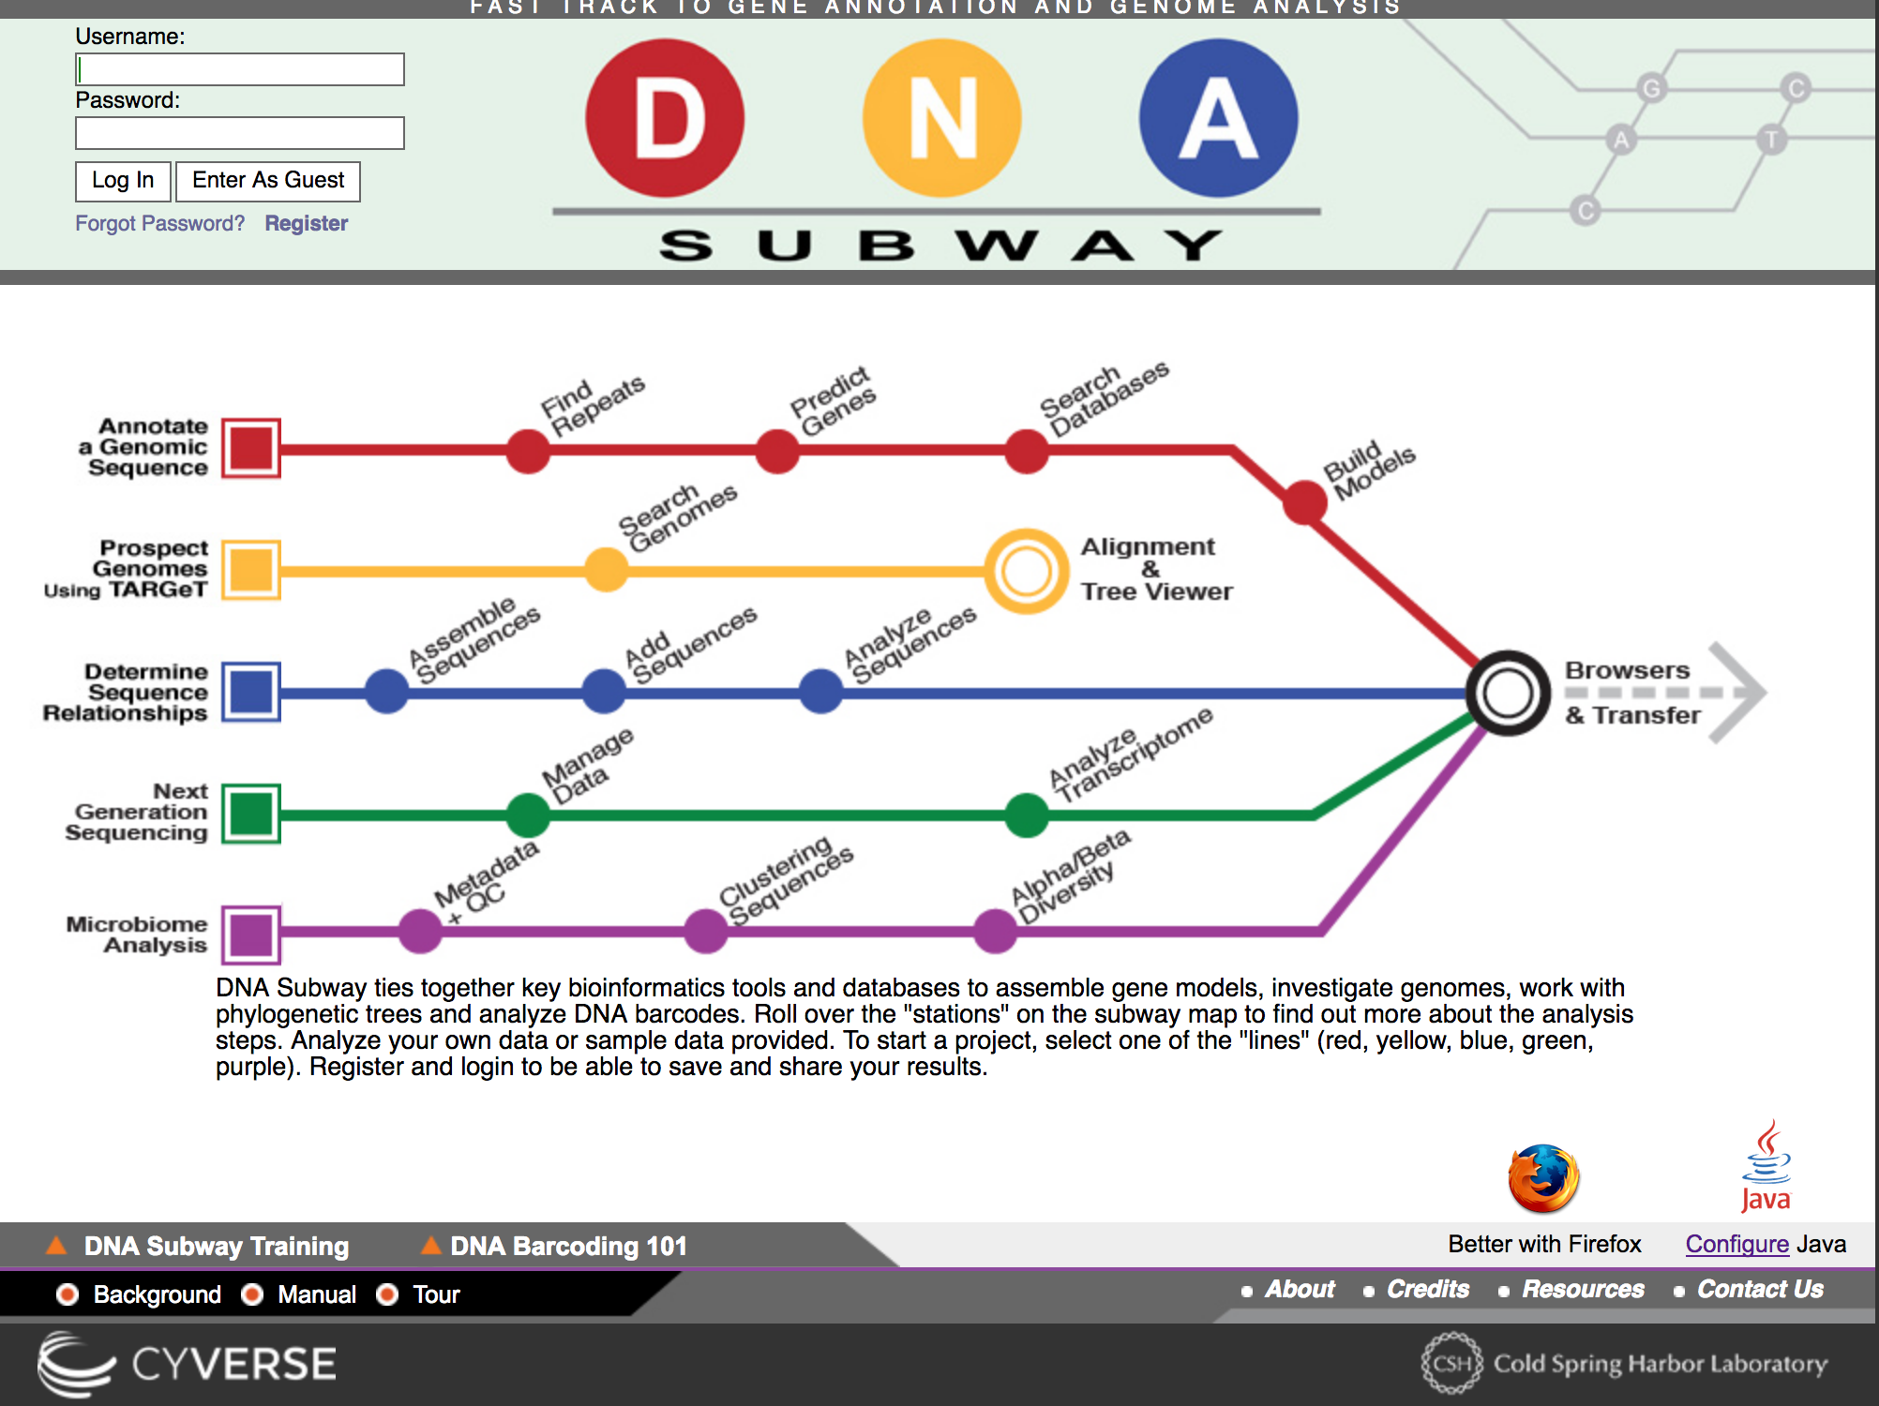
DNA Subway demo

